Slide 1


Virtual Computer Mouse using mmWave Radar (TI):
Oscar Chavez Araiza
Greyson Heath
Daniel Lu
Zane Meikle
ECEN 403

Slide 2
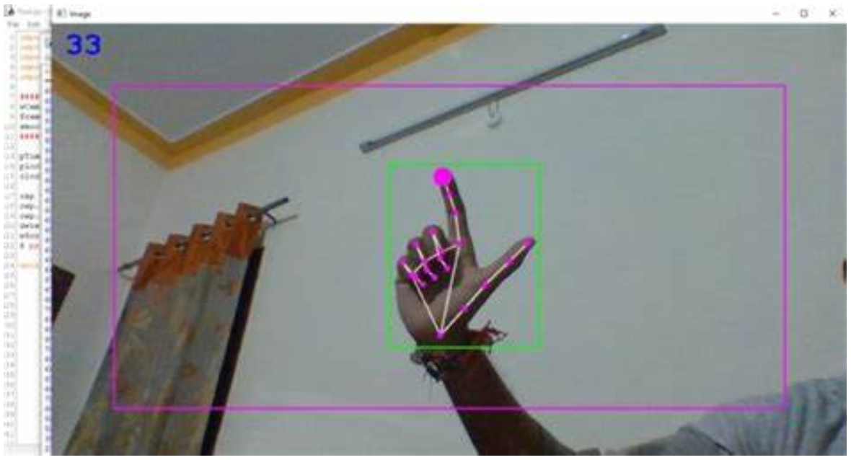
Project Description:
Problem statement:
Virtual mice today are traditionally done using computer vision and a camera (as seen on the right).
But these systems are processing and power intensive.
Solution proposal:
Create a virtual mouse using a Texas Instruments (TI) mmWave Radar and a ML model to make a less power and processing intensive virtual mouse.

Slide 3
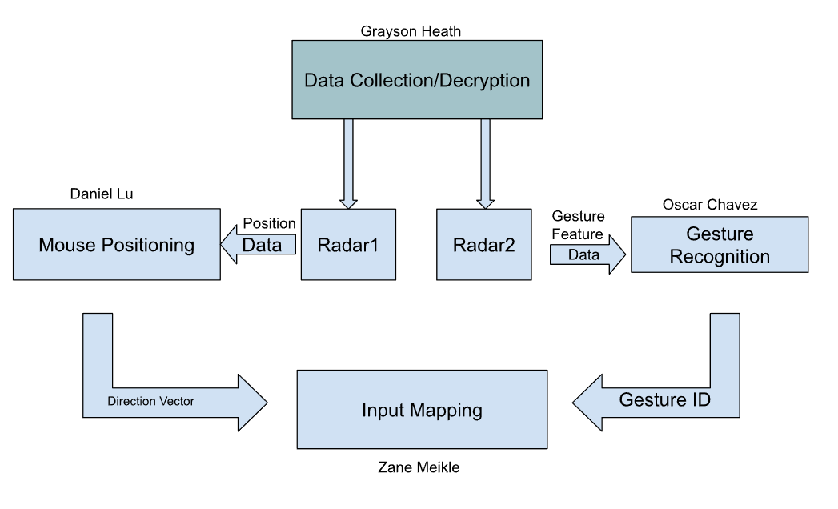
System Overview

Slide 4
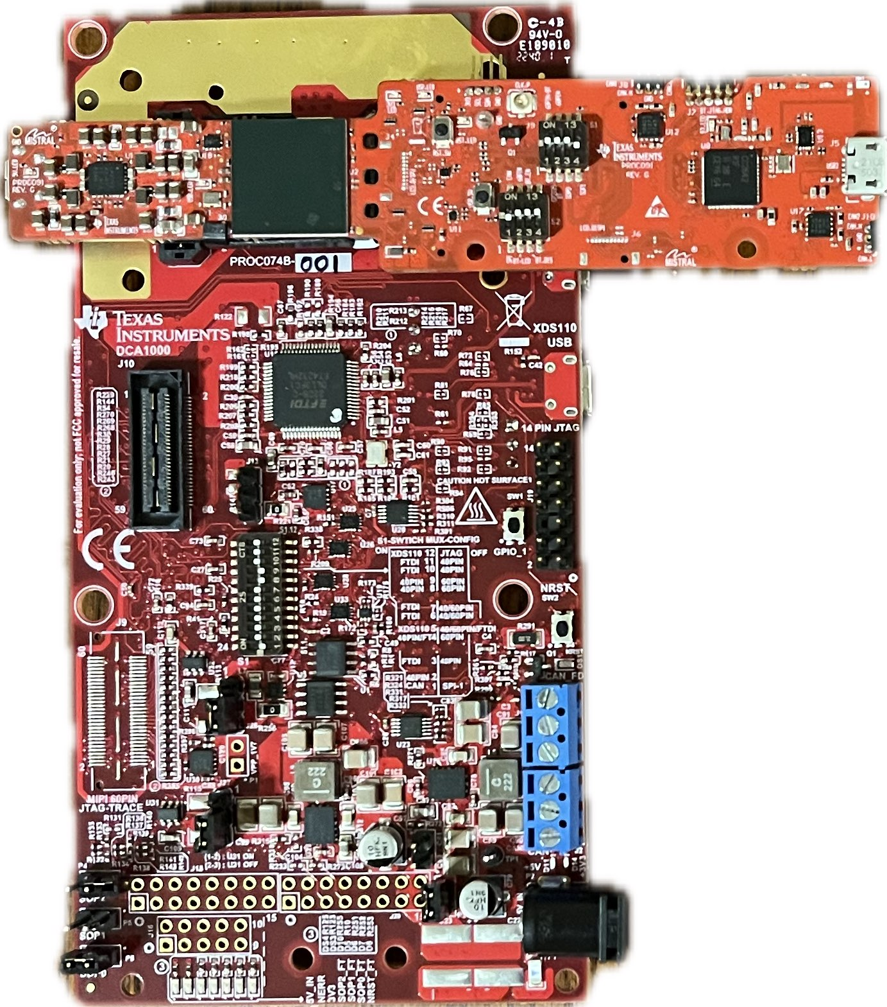
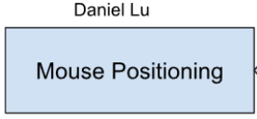
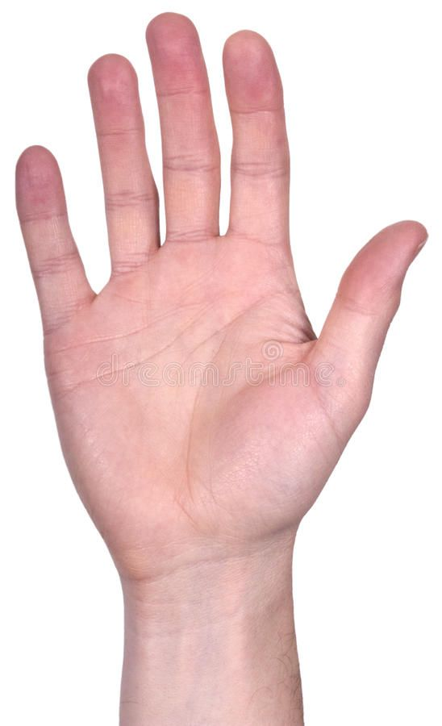


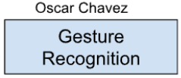
Chirp Config / Collect Data
Greyson Heath
Accomplishments since the last presentation <19> hrs | Current status and future progress
<5> Mouse Position Radar Tuning using Visualizer <10> Python UART Data Parser <2> Python UART Data Output Samples <2> Sponsor Meetings | Status: Both radars successfully run in parallel and output respective usable data, Improved tracking on mouse positioning radar Looking ahead (404): Connecting all subsystems, 3D printing mount for radars

Slide 5
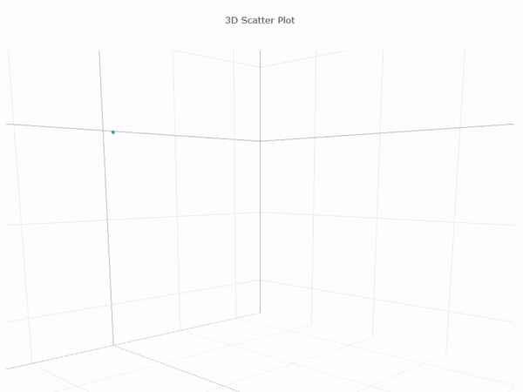
Hand Tracking on Pointer Radar

Slide 6
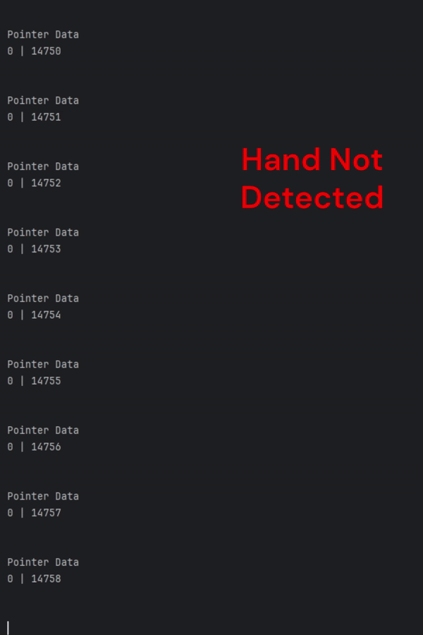
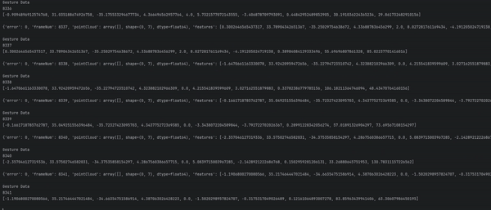
Terminal Output
Mouse Positioning Data
Gesture Data
Pointer Data
[# Points] | [Frame #]
Point 1: [X, Y, Z]
Point 2: [X, Y, Z]
…
Gesture Data
[Frame #]
Features: [size 10]
…
Notes:
Pointer Data: X, Y, Z, doppler, SNR, noise
Gesture Data: Weighted doppler, range, elevationMean, AzimuthMean

Slide 7
-Gesture Recognition-
Oscar Chavez Araiza
Accomplishments since the last presentation <~25> hrs | Ongoing progress/problems and plans until the next presentation
<3.5> Meeting(s) with sponsor <1> Made a python script to get training data. <4> Programed a CNN based model to take in a dataframe [40,10,1]. <~2> Initial testing of approach (training) <~10> Got training data and trained the model <1> Made a python script to feed live data to the model <3> Had to retrain parts of the model since some of the training data exceeded capturing distance <2> worked on demo. Got max distance and max angles (Azimutal, Elevation) | Problems TI’s parser has errors (My current approach ignores frames with errors) The further the hand the less accurate the model gets (might need to enhance data if range needs to be raised). I want to be able to mount the code to the radar thus decreasing user’s requirements(might not be possible) On-going progress Currently working on the demo. I’m calculating the practical accuracy rate and creating a simple gui for demo purposes.

Slide 8
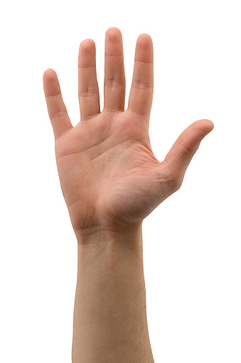
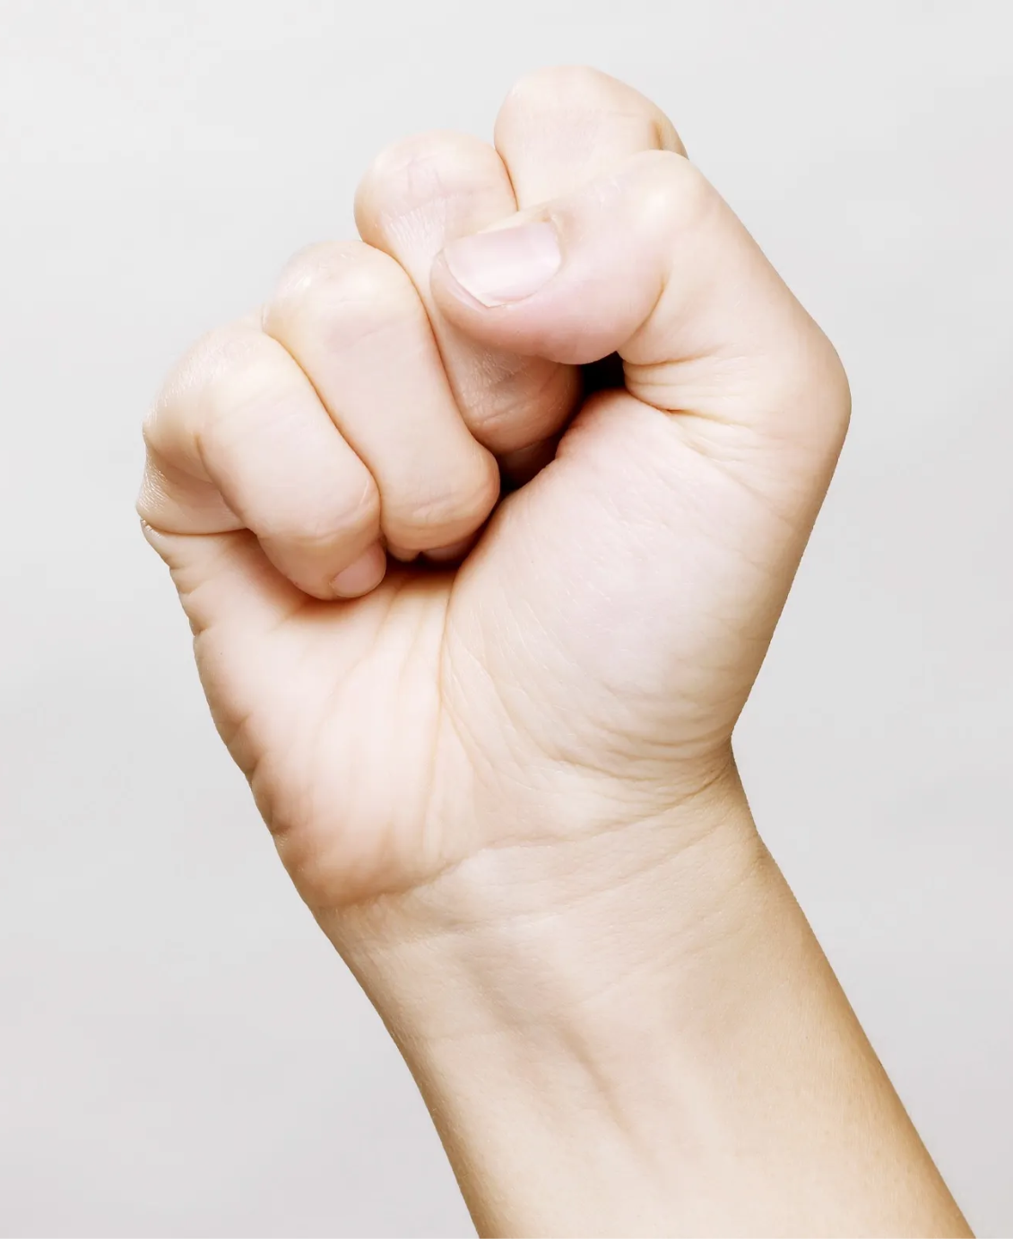
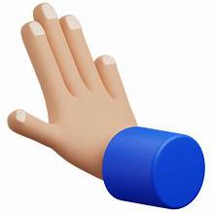

Gesture Recognition
Gesture 1 (L-Clk)
Shine Gesture
Gesture 2 (R-Clk)
Push Gesture

Slide 9
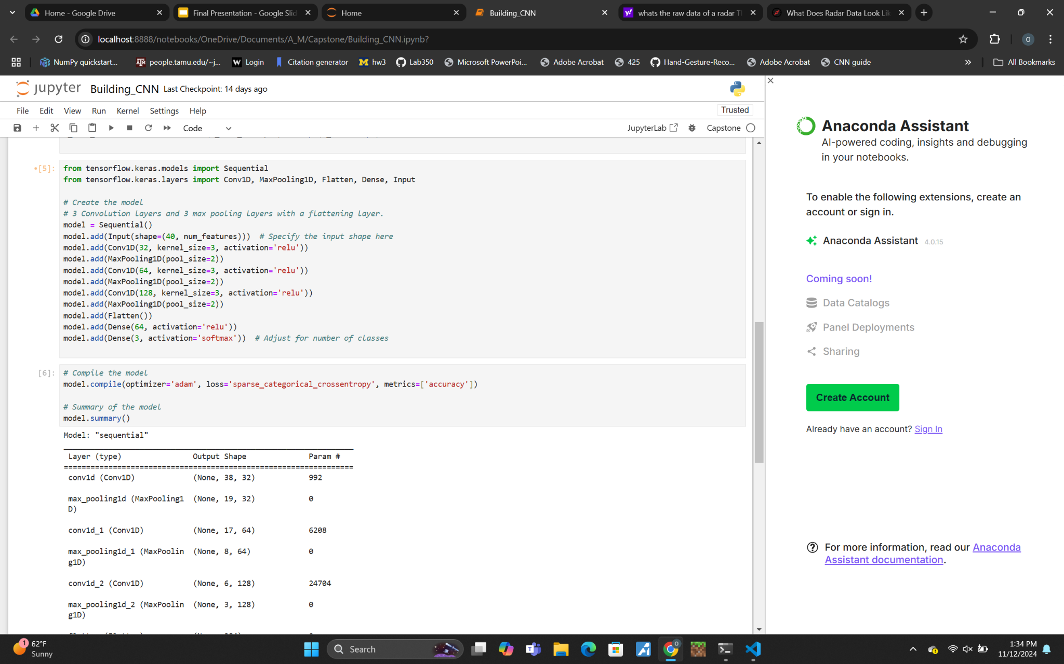
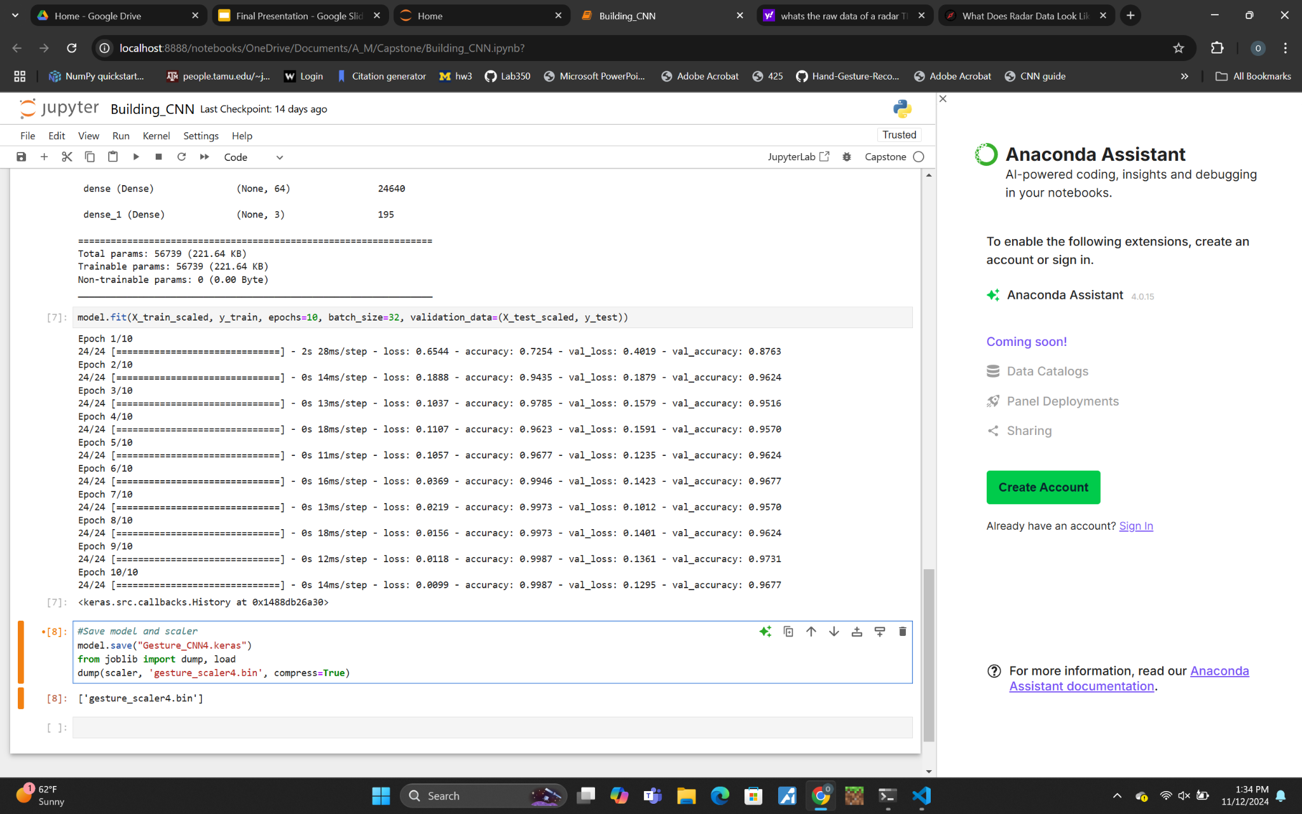
CNN Model
Structure: The model takes 40 frames each with 10 data points.
Layers: 3 Convolutional layers, and 3 max pooling layers.
Test Accuracy: ~ 96.77%

Slide 10
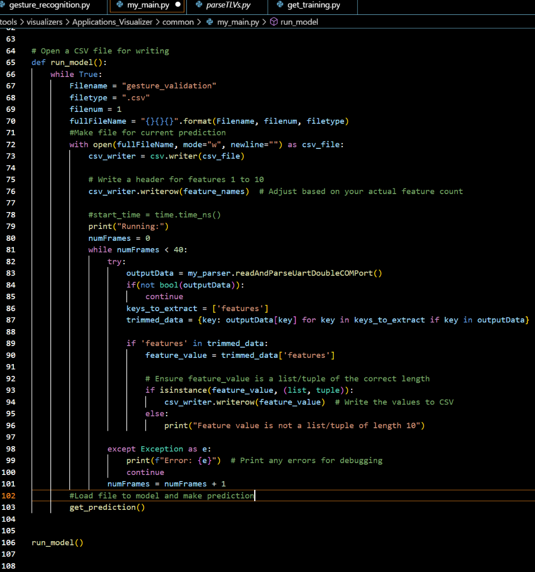
Running Model
This code is used to run the model in real time.
It is currently creating a csv file and loading that into the model. For future implementation it will directly create a DataFrame.
Final implementation will fill the first 40 frames and run the model prediction every 10* frames. (* - true value to be determined)
It takes about 1.4 seconds to capture 40 frames. (Negligible time to run it through the model)

Slide 11
Gesture Positioning
Daniel Lu
Accomplishments since the last presentation <21> hrs | Ongoing progress/problems and plans until the next presentation
<13> Using different approaches to the output moving path of the mouse to create two point cloud modeling demo code for positioning <3.5> Sponsor Meetings <3.5> Cooperate with Chirp Config demo to generate the output data <1> Generate sample data to test the result | Progress: Validation plans, path validation and error validation, are passed with high accuracy. Problems: The accuracy of output velocity or the moving path of the mouse needs to be considered to add environmental noise. The user is designed to move their hands in parallel from the x-y plane of the radar.

Slide 12
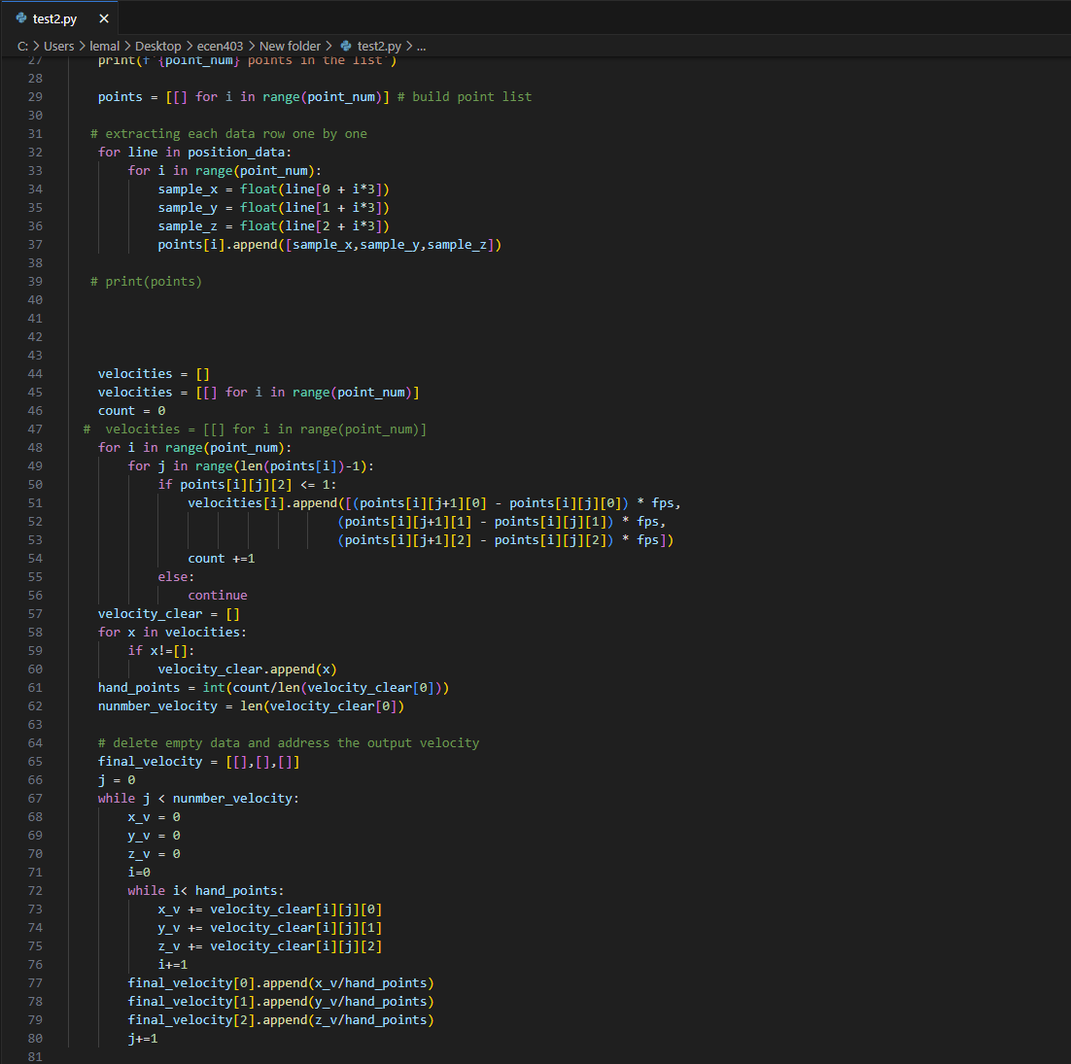
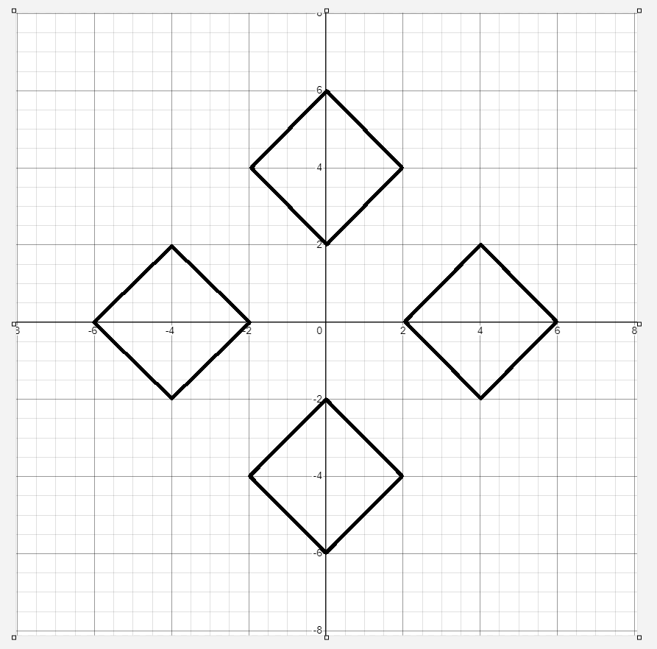
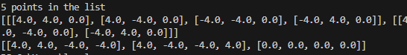
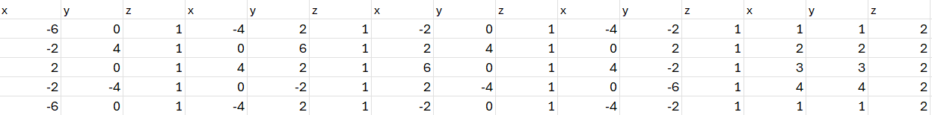

Slide 13
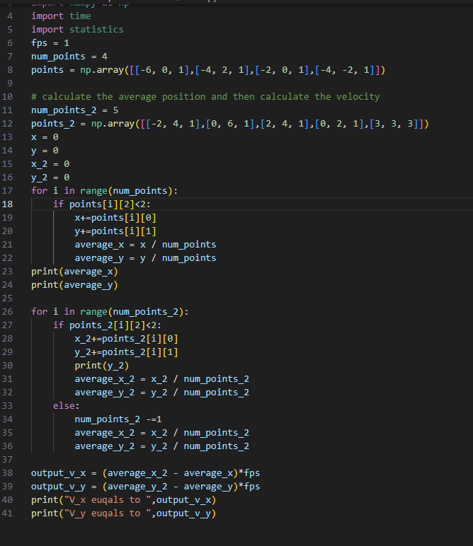
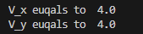

Slide 14
Input Mapping
Zane Meikle
Accomplishments since the last presentation <20> hours | Ongoing progress/problems and plans until the next presentation
<7> Writing and implementing code to test function <2> meetings with sponsor <4> Generating test data <6> Implementing error handling <1> Helping train Gesture Recognition model | Problems: Python sometimes runs too slow before the next frame, so I have it just skip the next frame. May not be an issue in the final implementation due to how the test program is set up but we will see if it’s an issue in 404. Ongoing Progress: Getting ready for demo and working on final report.

Slide 15
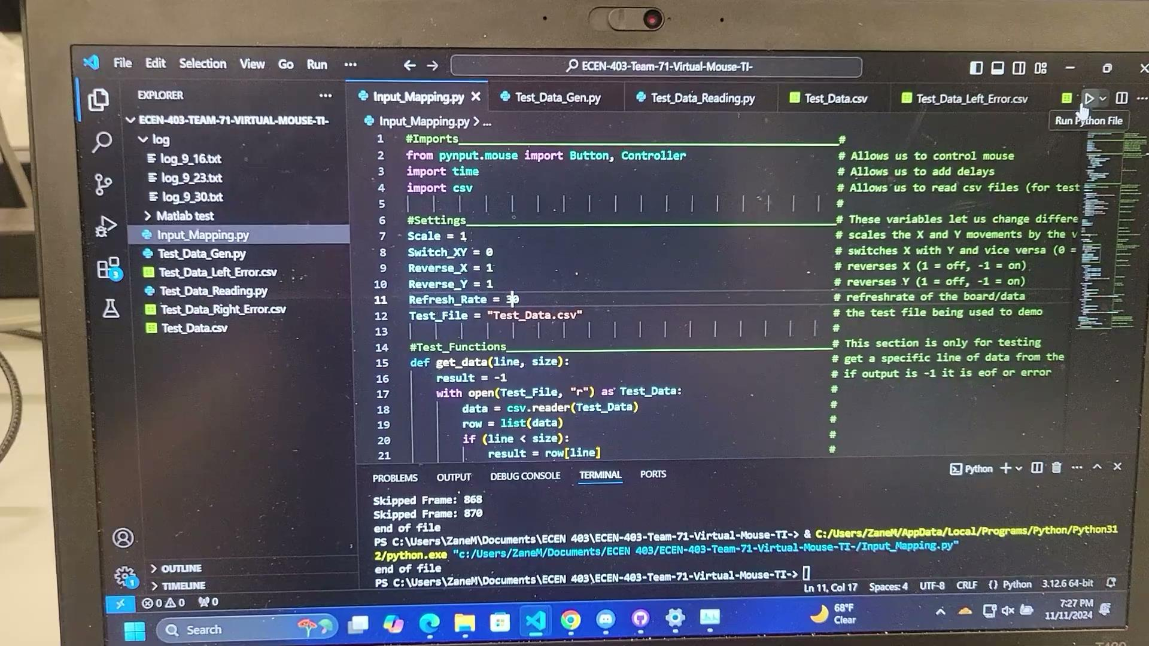
Mouse Movements and Actions

Slide 16
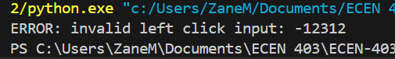
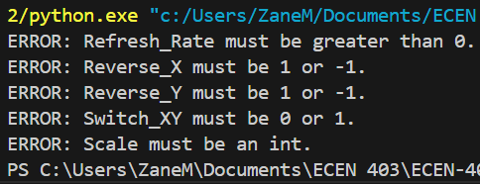
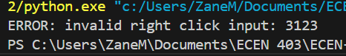
Error Handling Outputs
Invalid Left Click:
Invalid Settings:
Invalid Right Click:

Slide 17
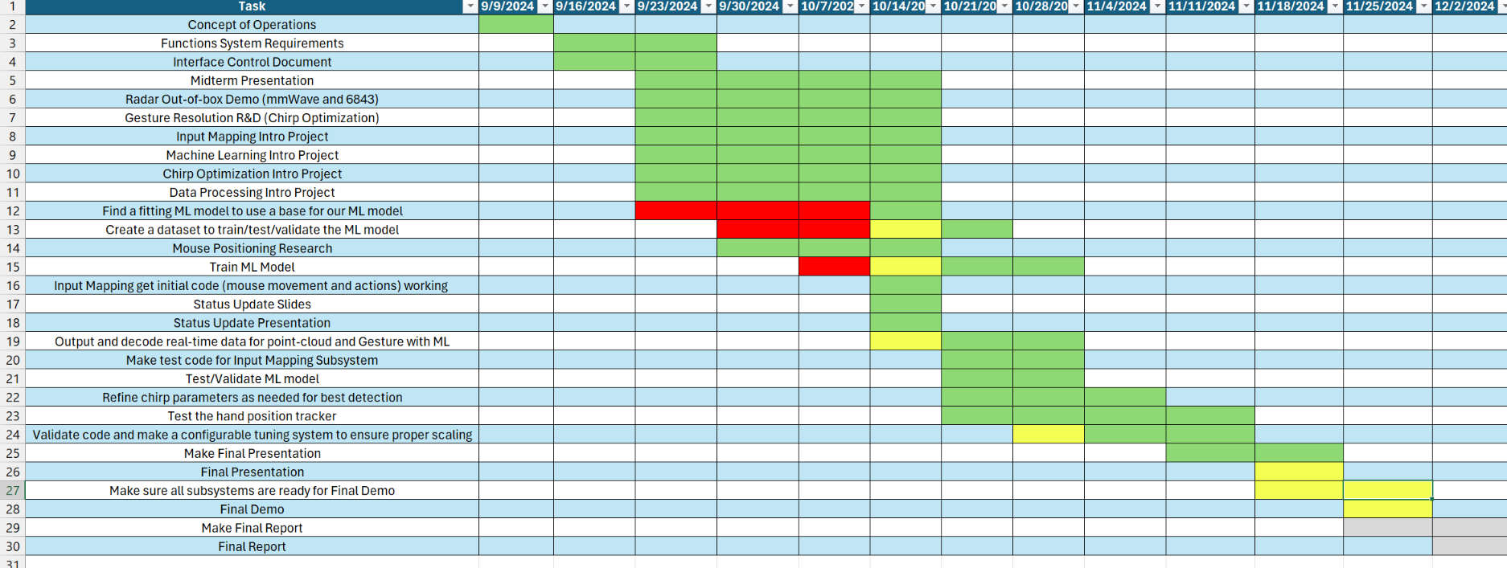
Execution Plan Gantt Chart

Slide 18
Validation Plan
Section | Task | Specification | Result | Owner
3.2.1.6 | Mouse Movement | Mouse can be moved to all corners of the screen by the program. | Passed | Zane
3.2.1.6 | Mouse Actions | The program must be able to right click and left click. | Passed | Zane
3.2.5.2 | Mouse Input Error Handling | The program must properly handle all invalid inputs. | Passed | Zane
3.2.1.4 3.2.1.6 | Gesture positioning | The coordinates of the gesture should be calculated when deleting the error points. | Passed | Daniel
3.2.1.6 3.2.1.8 3.2.3.2.1 | Velocity accuracy | The output velocity of the moving gesture should not have errors. | Passed | Daniel
3.2.1.5 | Hand Gesture Recognition | ML model can recognize the users hand gestures |  | Oscar

Slide 19
Validation Plan
Section | Task | Specification | Result | Owner
3.2.1.5 | Gesture Recognition Accuracy | ML model can correctly identify and categorize hand gestures at least 90% of the time. |  | Oscar
3.2.1.7 | Functional Radar System | The IWR6843AOPEVMs, and MMWAVEICBOOSTs all properly communicate with the computer and transmit data. | Passed | Greyson
3.2.1.8 | Data Decoding | The python script accurately decodes the TLV data seen from both radars. | Passed | Greyson
3.2.1.3 3.2.1.4 | Radar Angle and Distance | The radars can capture gestures and pointer positions within a 90 degree range up to 1.5 feet | Passed | Greyson
3.2.1.5 | Hand Size | Radar will recognize gestures regardless of hand size. |  | Oscar

